Slide 1
A Parallel Algorithm Template for
Updating Single-Source Shortest Paths
By
Muhammad Bilal 22i-0806
Rana Bilal Akbar 22i-1094
Mehboob Ali 22i-1208

Slide 2

Introduction
Targeted Subgraph Updates
Focuses on updating only affected subgraphs, avoiding full network recalculation.
Multi-Platform Compatibility
Framework supports both GPUs and multi-core CPUs for diverse computing environments.
Performance Gains
Achieves up to 5.6x speedup over existing methods and efficiently processes up to 100 million changes in batch.
Parallel Change Detection
Identifies affected subgraphs in parallel, optimizing update speed.

Slide 3
Sequential Algorithms for SSSP
Dynamic network changes
Updating shortest paths in response to edge insertions or deletions in a dynamic network.
Priority queue utilization
A priority queue helps manage nodes needing updates based on their shortest path changes.
Distance updates for edges
Apply Dijkstra algorithm again to affected nodes.
.
Limitations
Redundant updates can occur, making this approach less suitable for extensive networks.

Slide 4




GPU-Based Implementation
Bellman-Ford on Kepler GPUs
JavaScript Implementation
Gunrock Library
Uses advance, filter, and compute steps for efficient pathfinding on GPUs.
Employs dynamic parallelism but faces atomic operation bottlenecks.
Effective for dynamic networks with less than 10% edge changes.
CPU-Based Implementation
Dynamically Adaptive
Static graph implementations
Galois model
Only known shared-memory solution for dynamic graph updates, unlike static graph methods.
Includes two shared-memory implementations of the D-stepping algorithm on static graphs.
Supports graph algorithms like Dijkstra’s but does not accommodate dynamic updates.

Slide 5




Efficient Parallel Algorithm for SSSP Updates
Edge Handling
2
Processes deletions by disconnecting nodes; additions checked for shorter paths.
Affected Node Detection
1
Identifies and marks nodes impacted by edge changes in parallel.
3
New edge addition
Checks new edges for shorter paths and updates parent and distance accordingly.
5
5
Cycle Prevention
Resets disconnected tree parts to avoid cycles before adding new edges.
4
Dynamic Scheduling
Distributes work evenly across processors for optimal efficiency.

Slide 6
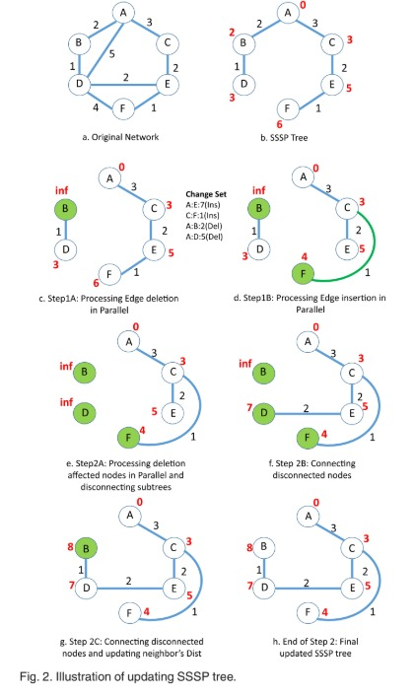
Updating SSP TREE

Slide 7
Shared-Memory Implementation
1
OpenMP Parallelization
Utilizes OpenMP to parallelize shortest path updates on multi-core CPUs.
2
Edge Deletion First
Processes deletions before insertions to maintain shortest path correctness.
3
Affected Flag
Each vertex uses a flag to indicate if its path needs recalculation.
4
Asynchronous Updates
Reduces thread synchronization frequency for better performance.
5
Batch Processing
Handles edge updates in batches to balance load and avoid memory issues.

Slide 8

Efficient GPU Implementation of SSSP
Parallel Thread Execution
CUDA enables simultaneous processing for speed and efficiency.
Vertex Marking
VMFB structure checks and marks affected vertices efficiently.
Subtree Disconnection
Entire subtrees are disconnected when edges are deleted.
Iterative Updates
Repeats until all changes are resolved, ensuring correctness.
Handling Edge changes
The algorithm checks for both edge deletions and insertions to determine affected vertices.

Slide 9

Proposed Parallelization Strategy
Approach
Distributed Processing with MPI
Combines METIS for partitioning, MPI for distributed processing, and OpenMP for shared memory updates.
MPI processes manage partitions and handle communication for edge changes and updates.
Graph partitioning
OpenMP for shared memory
Partition input graph into chunks matching MPI processes while maintaining ghost zones
Uses OpenMP within MPI processes for local edge processing and distance updates.
Testing & Metrics
Evaluates performance on road, social, and synthetic networks, comparing sequential, MPI, and hybrid methods.

